Slide 1
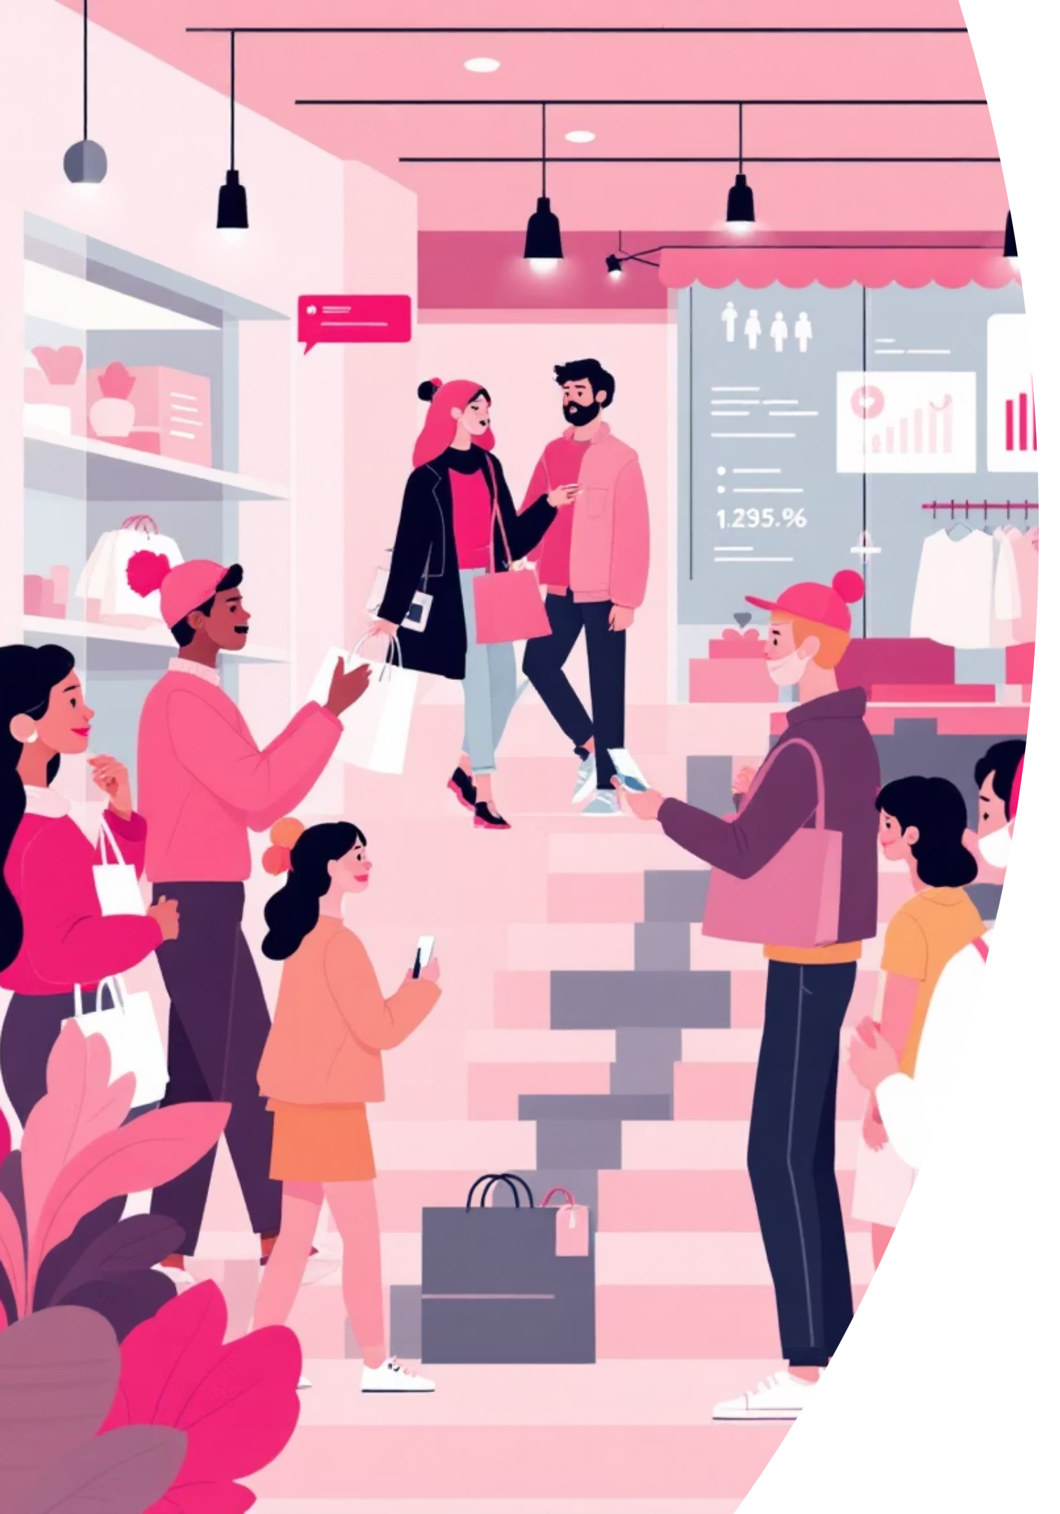
Customer Shopping Behavior Analysis
This project analyzes customer shopping behavior using transactional data from 3,900 purchases. Our goal is to uncover insights into spending patterns, customer segments, product preferences, and subscription behavior to guide strategic business decisions.

Slide 2


Dataset Summary
Our dataset comprises 3,900 rows and 18 columns, offering a comprehensive view of customer interactions.
Customer Demographics: Age, Gender, Location, Subscription Status
Purchase Details: Item Purchased, Category, Purchase Amount, Season, Size, Color
Shopping Behavior: Discount Applied, Promo Code Used, Previous Purchases, Frequency of Purchases, Review Rating, Shipping Type
Missing Data: 37 values in the Review Rating column were imputed using the median rating per product category.

Slide 3

Exploratory Data Analysis: Python
Data Loading & Exploration
Imported dataset with pandas, checked structure with df.info() and summary statistics with .describe().
Missing Data Handling
Imputed missing 'Review Rating' values using the median rating of each product category.
Column Standardization
Renamed columns to snake_case for improved readability and consistency.
Feature Engineering
Created age_group by binning ages and purchase_frequency_days from purchase data.

Slide 4

Data Analysis: SQL Insights
Structured analysis in PostgreSQL answered key business questions, revealing critical patterns in customer behavior.
Revenue by Gender
High-Spending Discount Users
Top 5 Products by Rating
Male customers generated significantly more revenue ($157,890) than female customers ($75,191).
Gloves (3.86), Sandals (3.84), Boots (3.82), Hat (3.80), and Skirt (3.78) received the highest average ratings.
Identified 839 customers who used discounts but still spent above the average purchase amount.

Slide 5


Shipping & Subscription Impact
Shipping Type Comparison
Subscribers vs. Non-Subscribers
Express shipping users had a higher average purchase amount ($60.48) compared to Standard shipping ($58.46).
Non-subscribers (2,847 customers) contributed more total revenue ($170,436) than subscribers (1,053 customers, $62,645).

Slide 6
Discount & Product Insights
50%
49.66%
49.07%
Hat
Sneakers
Coat
Highest percentage of discounted purchases.
Second highest discount dependency.
Significant portion of sales with discounts.
48.17%
47.37%
Sweater
Pants
High reliance on discounts for sales.
Nearly half of purchases involved discounts.
These products show the highest dependency on discounts for sales, indicating potential for strategic pricing adjustments.

Slide 7



Customer Segmentation
Customers were classified into three segments based on their purchase history.
New
83 Customers
First-time purchasers.
Loyal
3,116 Customers
Frequent and consistent buyers.
Returning
701 Customers
Customers with multiple, but not frequent, purchases.

Slide 8
Top Products by Category
1
Accessories
Jewelry
171
1
Clothing
Blouse
171
1
Footwear
Sandals
160
1
Outerwear
Jacket
163
This table highlights the most purchased items within each product category, providing insights for inventory and marketing strategies.

Slide 9
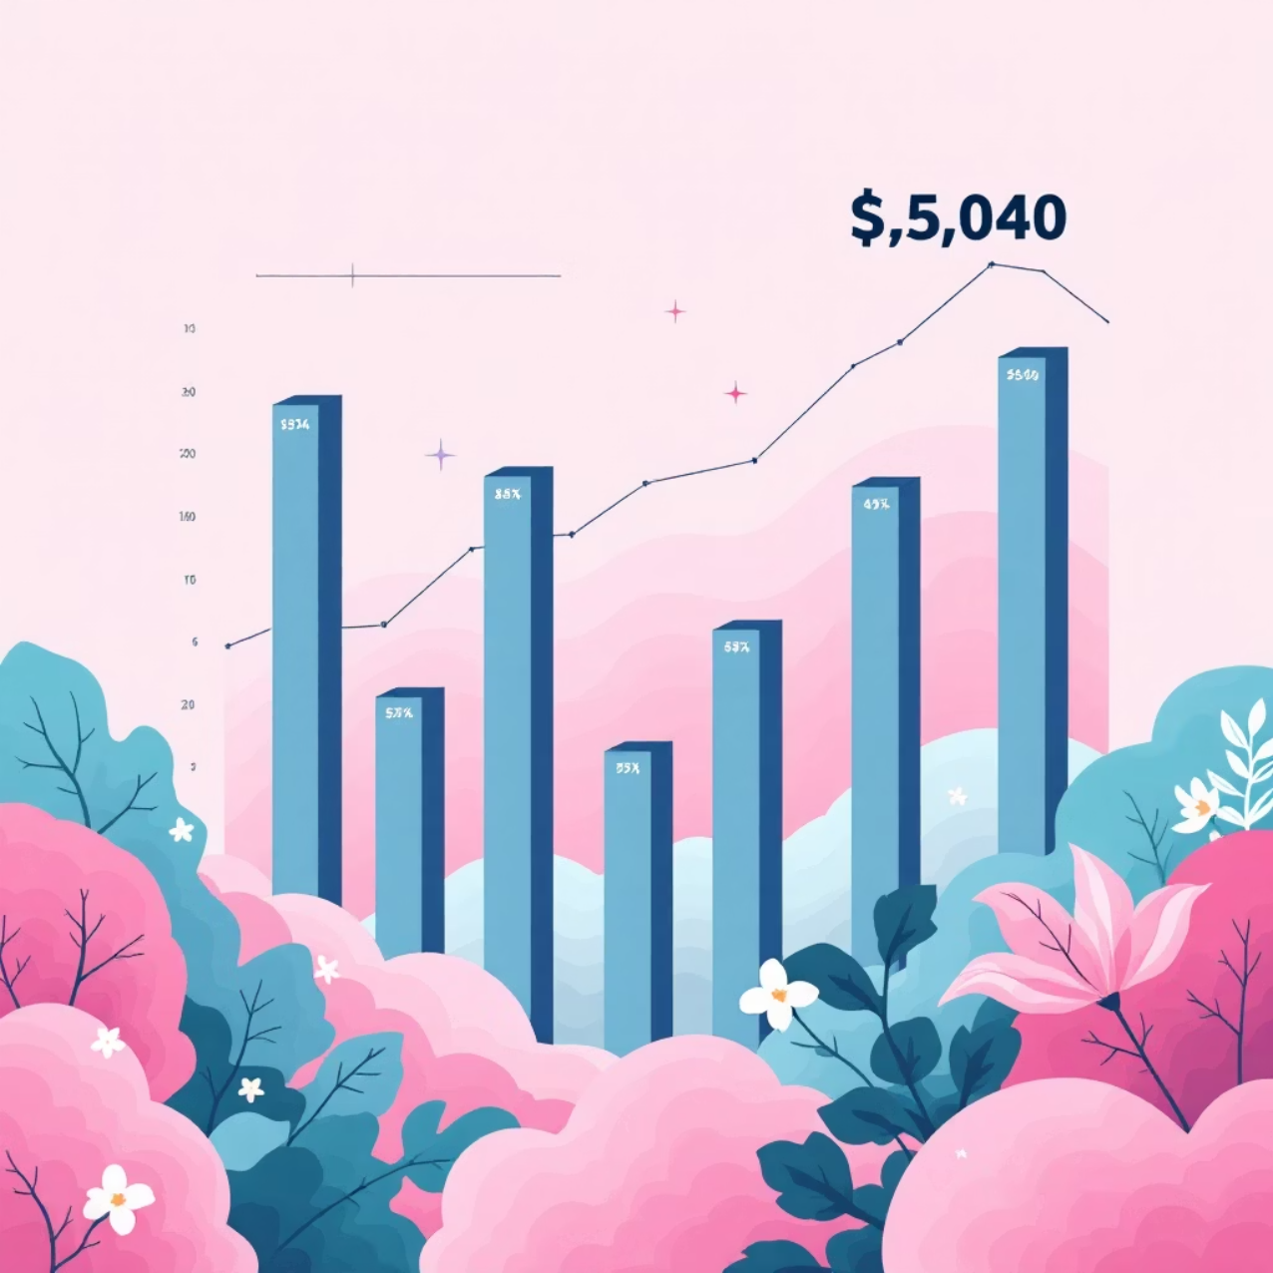

Repeat Buyers & Age Group Revenue
Repeat Buyers & Subscriptions
Revenue by Age Group
Customers with more than 5 purchases are more likely to subscribe. 958 repeat buyers are subscribers, compared to 2,518 non-subscribers.
Young Adults (62,143) and Middle-aged (59,197) groups contribute the most revenue, followed by Adults (55,978) and Seniors (55,763).

Slide 10
Business Recommendations
1
2
3
Boost Subscriptions
Customer Loyalty Programs
Review Discount Policy
Promote exclusive benefits to increase subscriber base and engagement.
Reward repeat buyers to foster loyalty and transition them into the "Loyal" segment.
Strategically adjust discount offerings to balance sales boosts with profit margins.
4
5
Product Positioning
Targeted Marketing
Highlight top-rated and best-selling products in marketing campaigns to maximize appeal.
Focus marketing efforts on high-revenue age groups and express-shipping users for optimal ROI.

